Slide 1
Case Study service: Refurbishment equipment: refurbishment of COMPONENTS OF CW PUMP
EKA PRESS TECHNO SERVICES PVT. LTD.

Slide 2
COOLING WATER PUMP
The worn out & damaged different components of CW Pump of 500 MW Thermal Power Plant are repaired by Refurbishment.

Slide 3
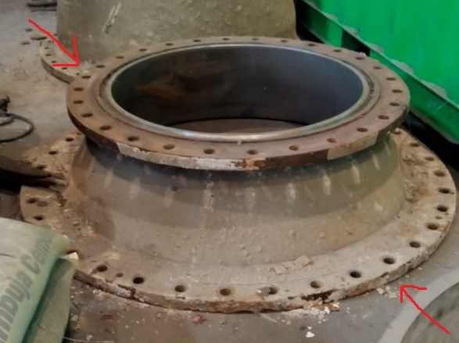
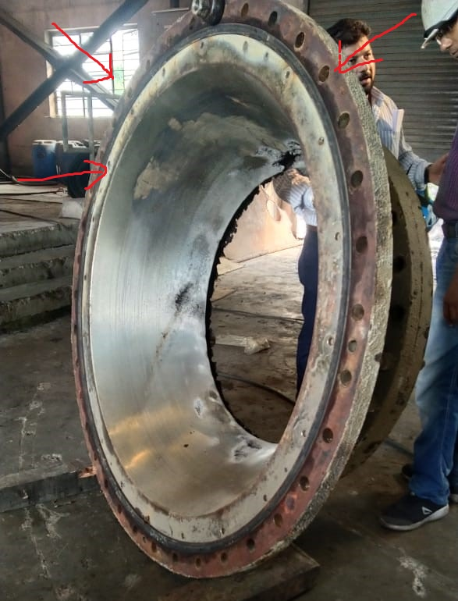
before execution of job
Worn out & Damaged Impeller Casing of CW Pump

Slide 4
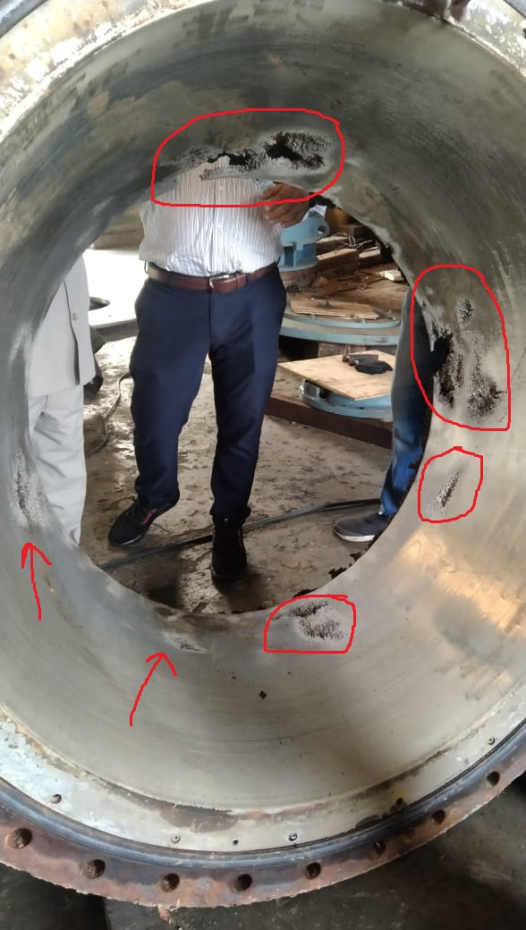
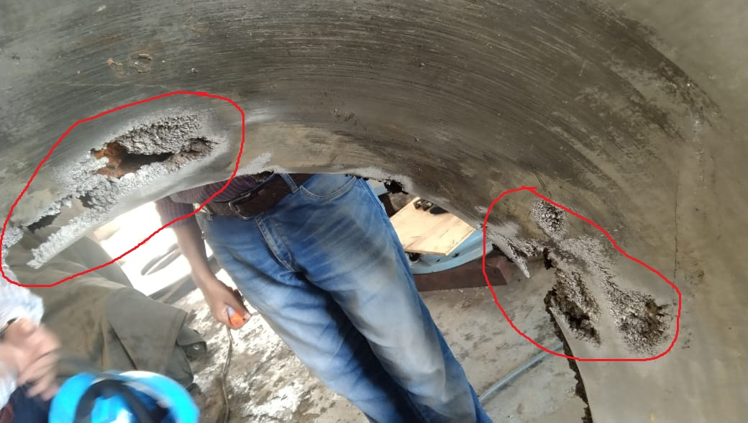
before execution of job
Worn out & Damaged Impeller Casing of CW Pump

Slide 5
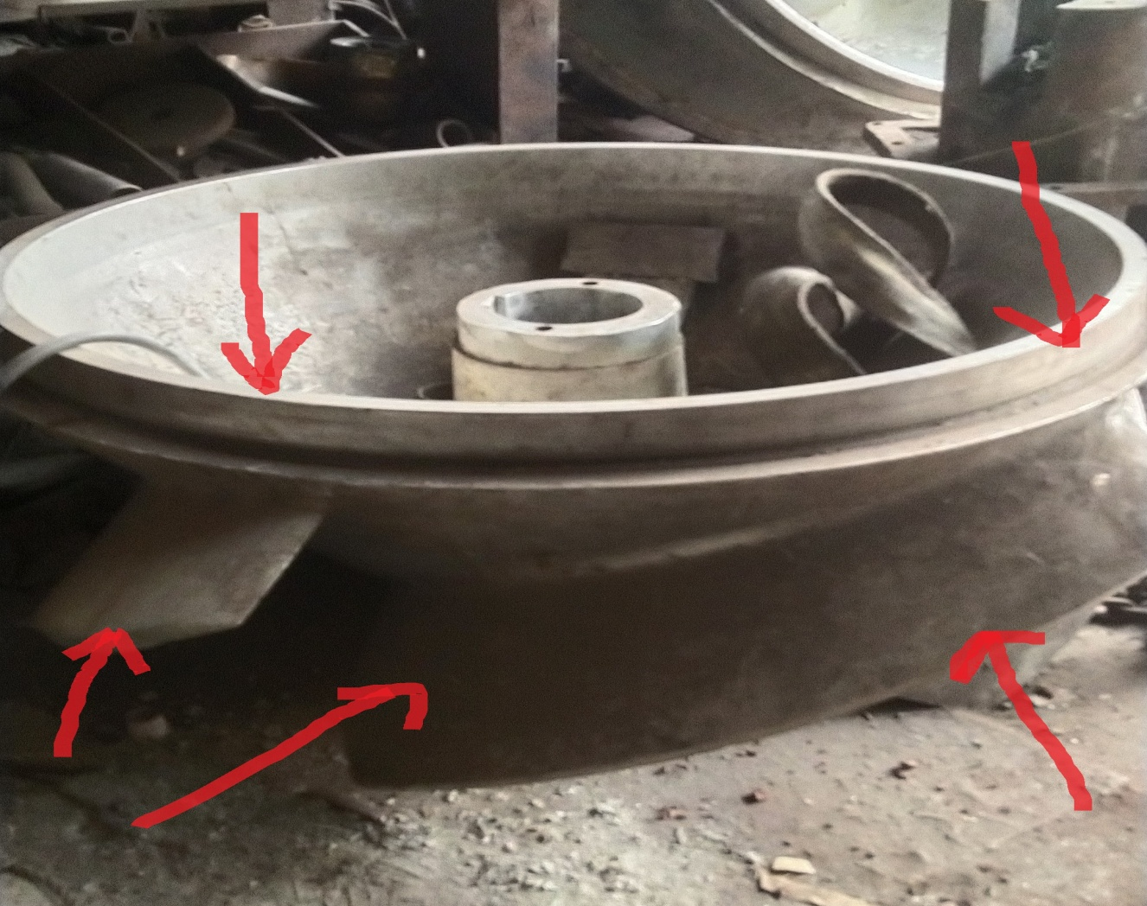
before execution of job
Worn out & Damaged Impeller of CW Pump

Slide 6
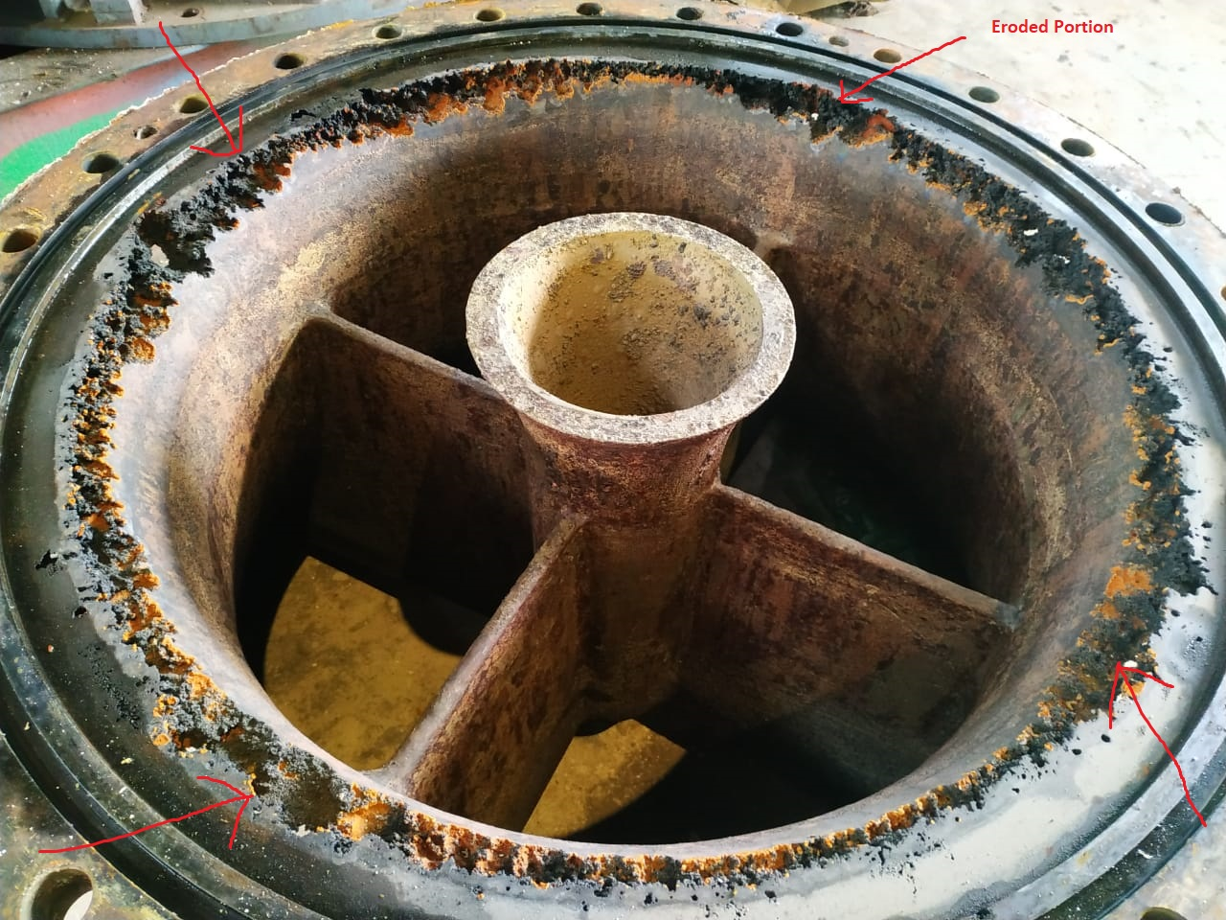
before execution of job
Worn out & Damaged Suction Bell Mouth of CW Pump

Slide 7
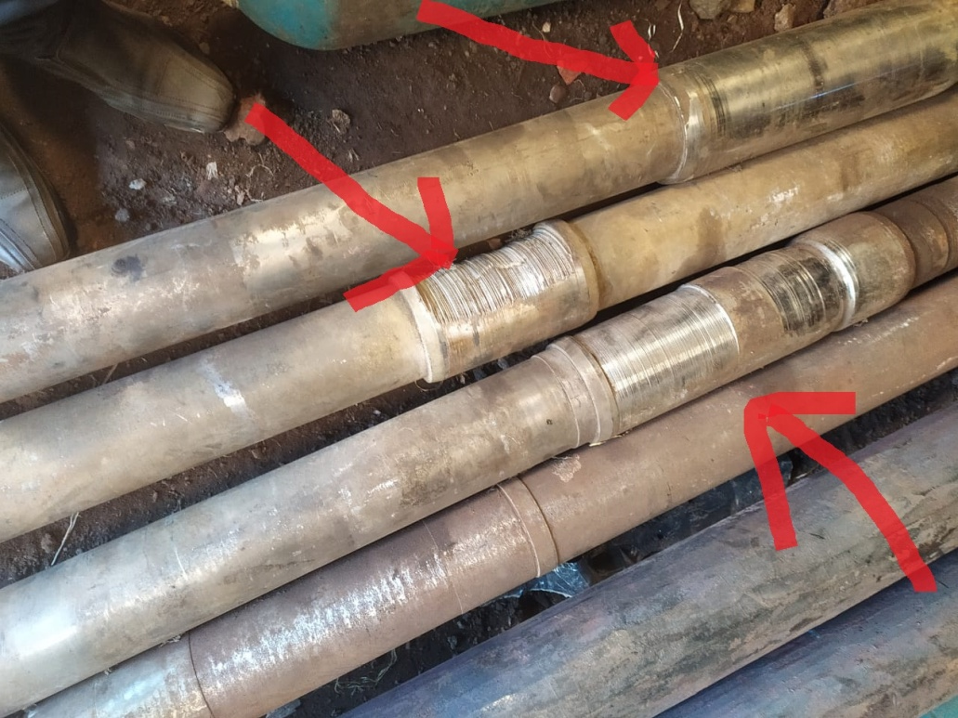
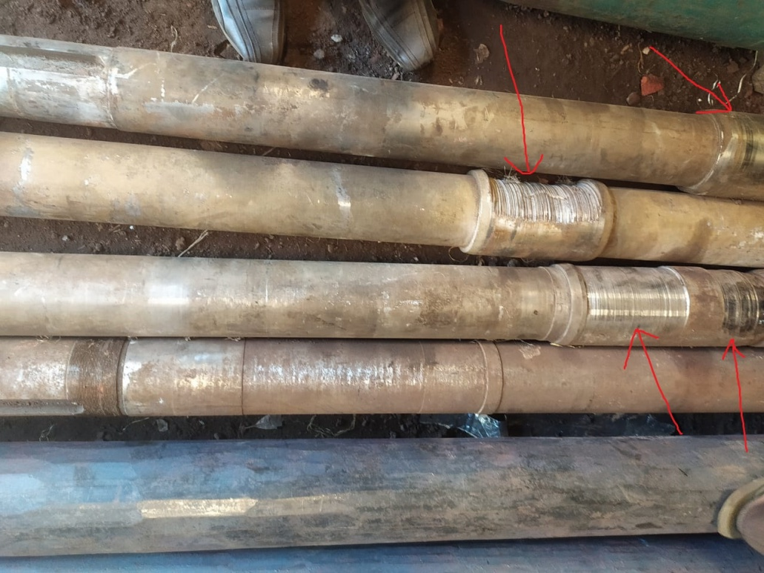
before execution of job
Worn out & Damaged Shafts of CW Pump

Slide 8
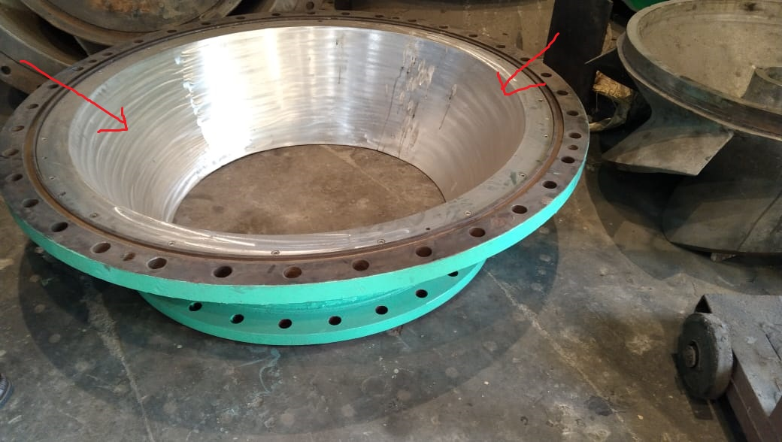
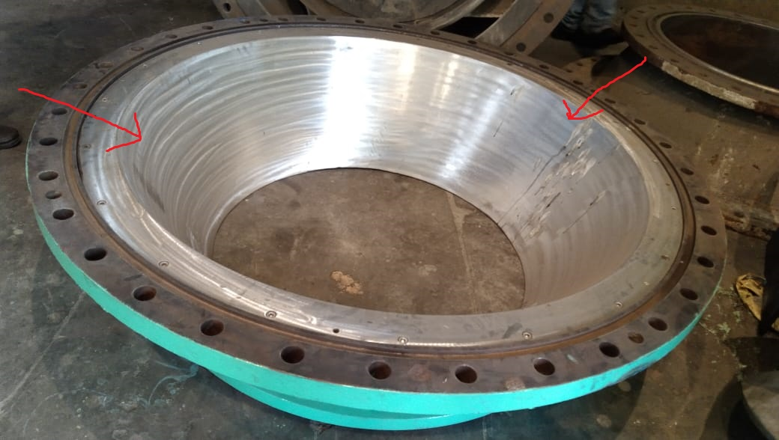
after execution of job
Damaged Impeller Casing of CW Pump have been repaired by Refurbishment Process

Slide 9
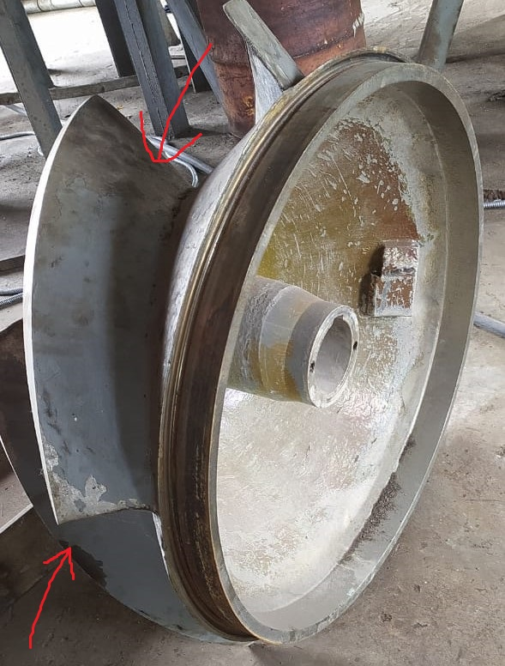
after execution of job
Damaged Impeller of CW Pump have been repaired by Refurbishment Process

Slide 10
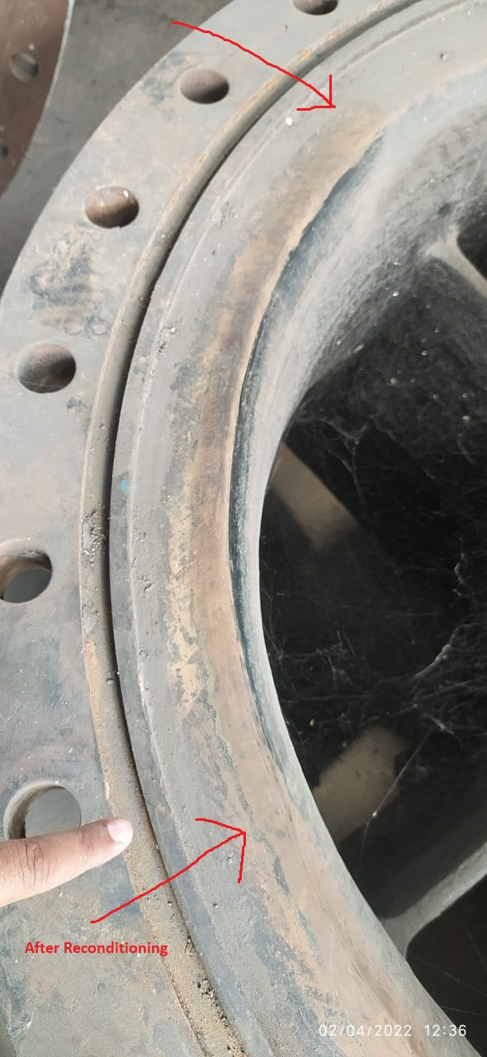
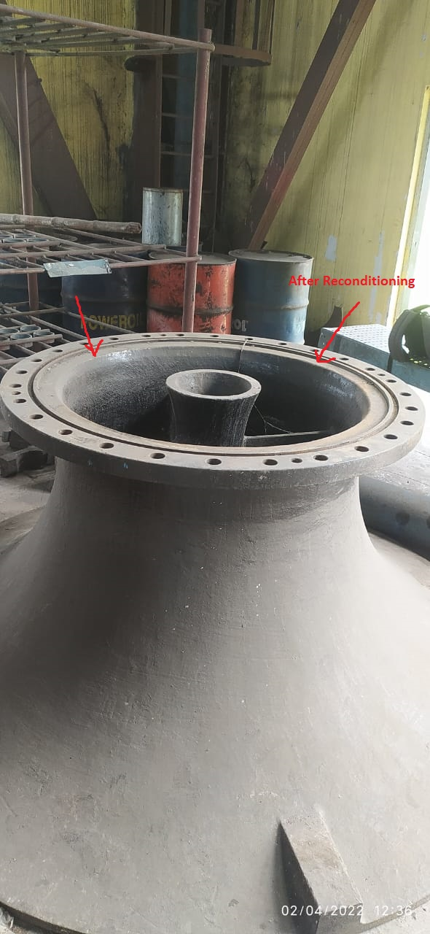
after execution of job
Damaged Suction Bell Mouth of CW Pump have been repaired by Refurbishment Process

Slide 11
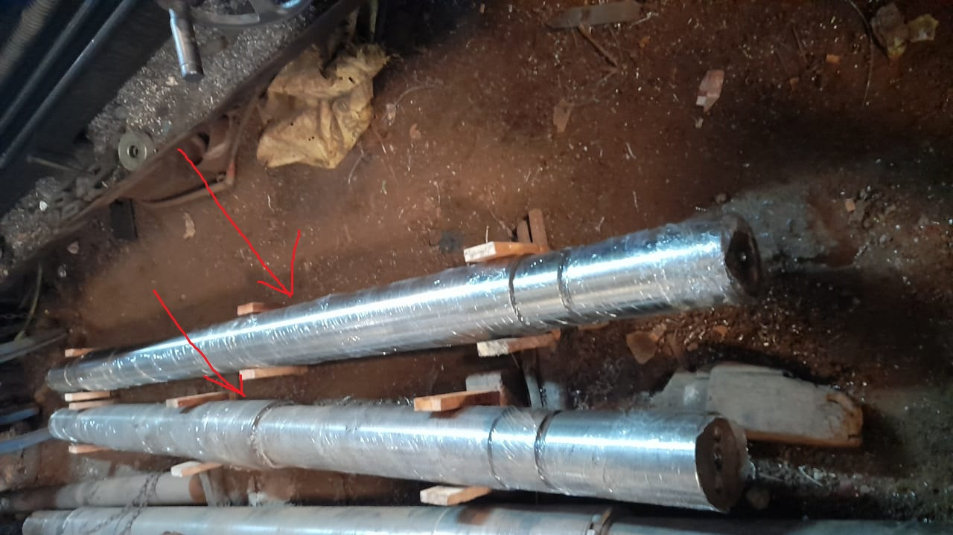
after execution of job
Damaged Shafts of CW Pump have been repaired by Refurbishment Process

Slide 12
THANK YOU

