Slide 1
Case Study service: COATING equipment: COATING of CW PUMP
EKA PRESS TECHNO SERVICES PVT. LTD.

Slide 2
COOLING WATER PUMP
The corroded & eroded components of CW Pump can be protected by Coating Service using Duromar Product.

Slide 3
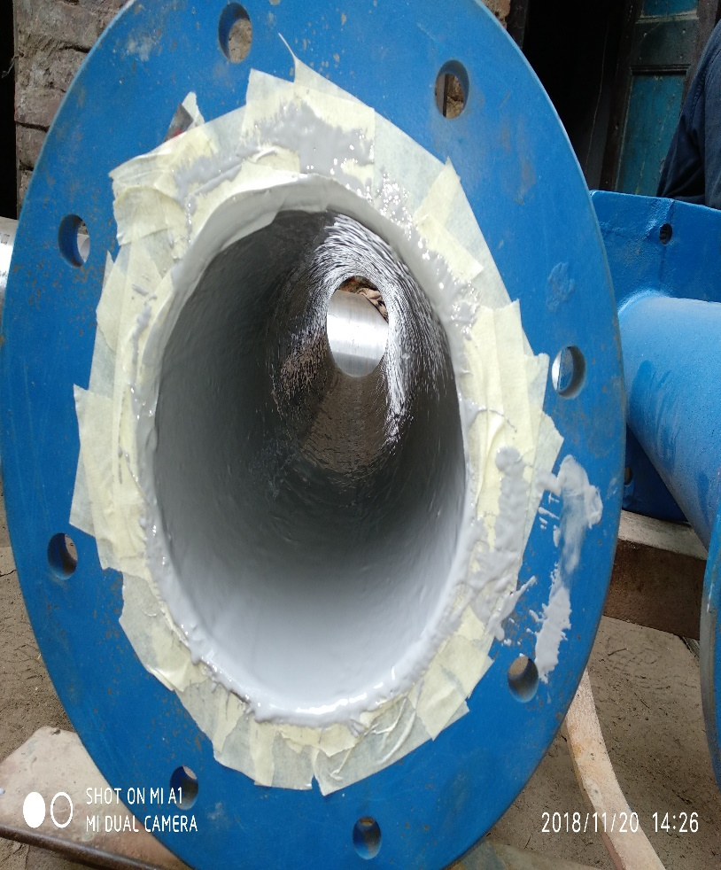
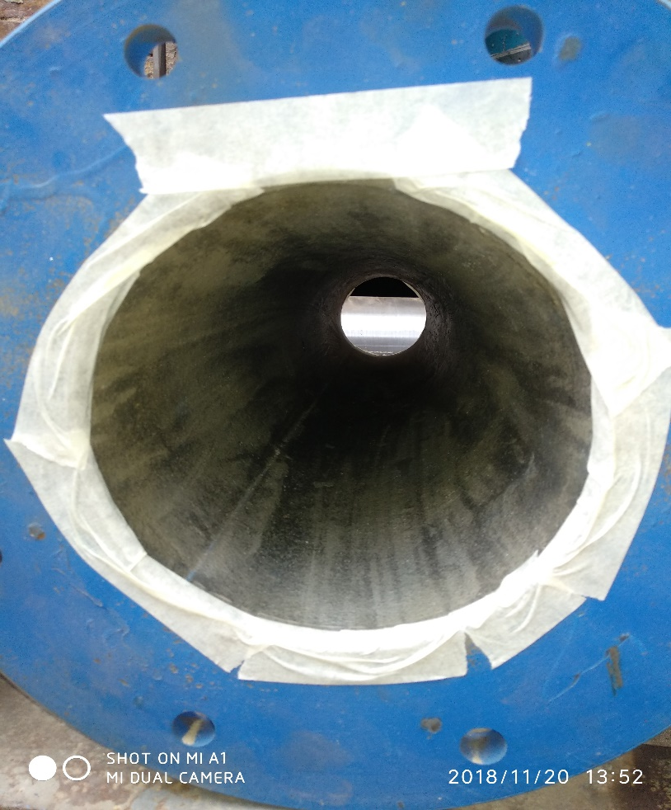
Column pipe
Before Application
After Application

Slide 4
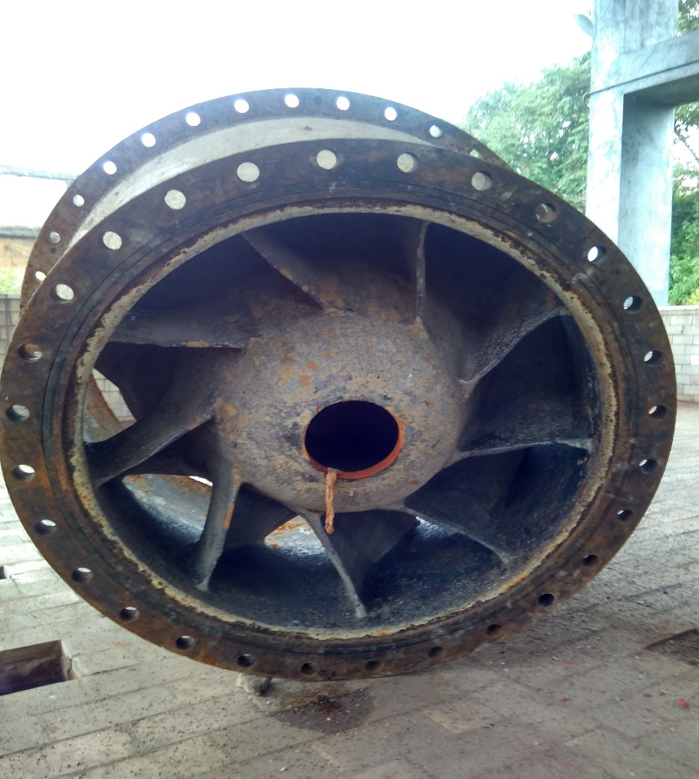
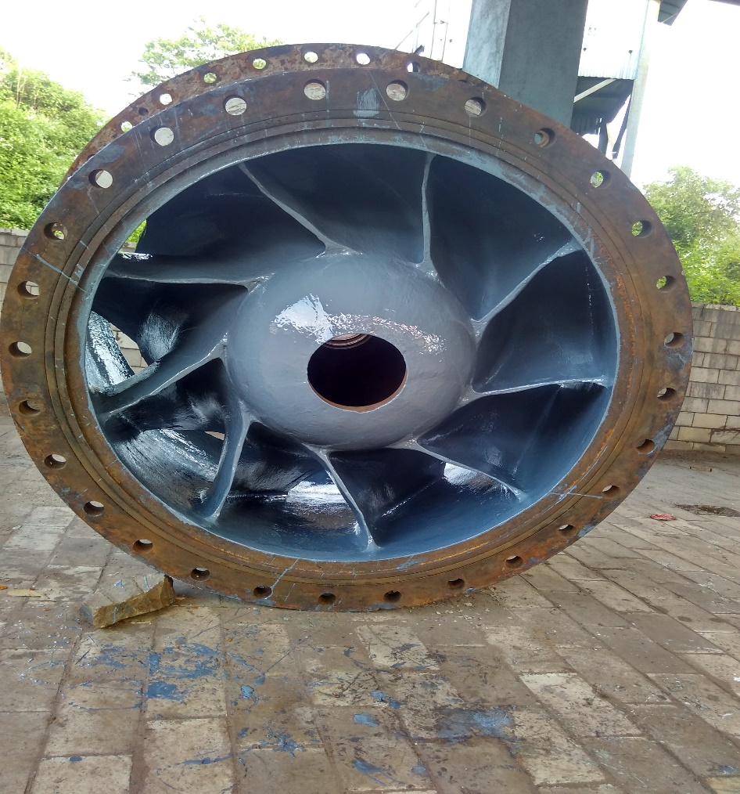
Discharge bowl
Before Application
After Application

Slide 5
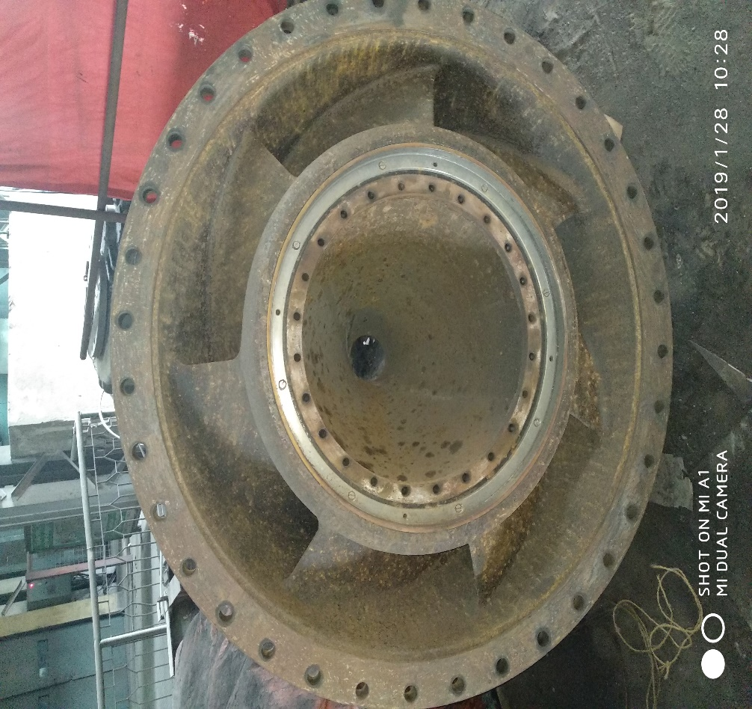
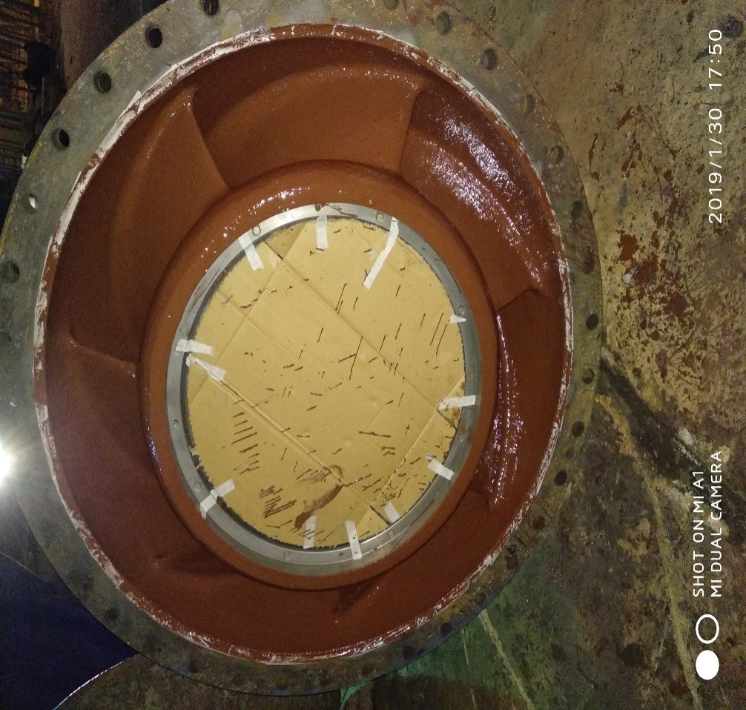
impeller
Before Application
After Application

Slide 6
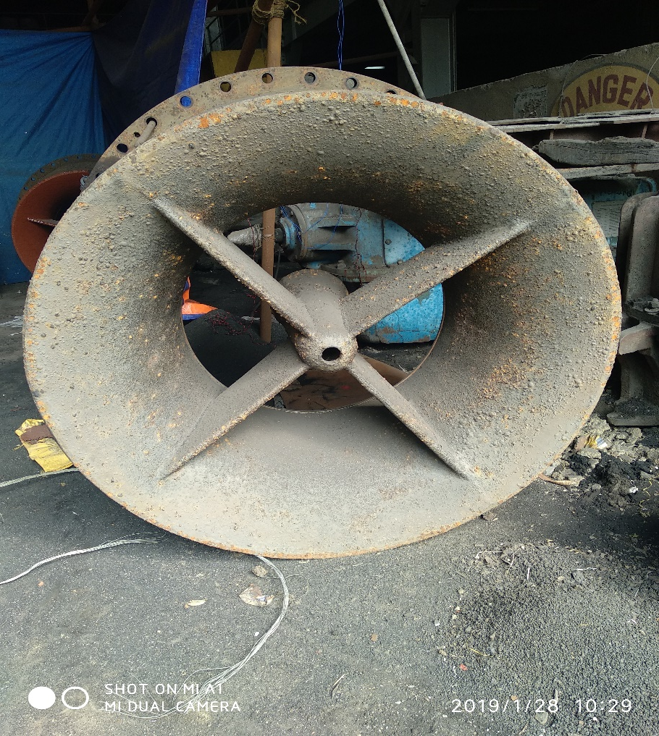
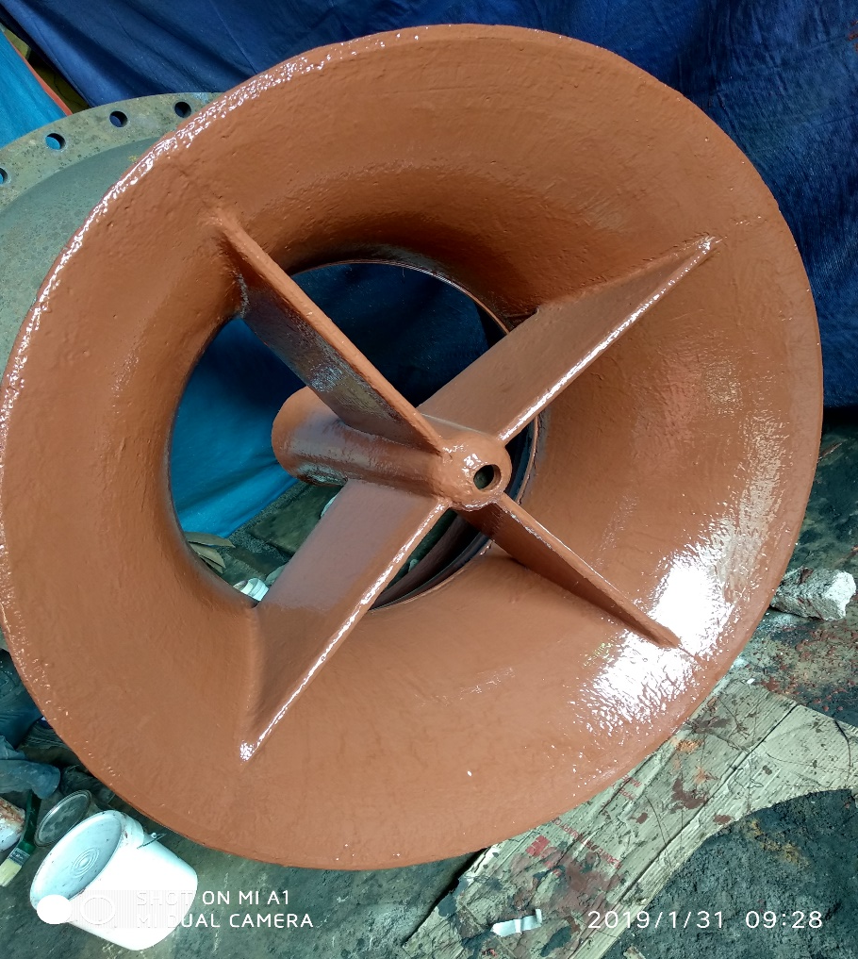
Suction bell mouth
Before Application
After Application

Slide 7
THANK YOU

