Slide 1
Case Study service: Refurbishment equipment: refurbishment of TRANSMISSION HOUSING & engine block
EKA PRESS TECHNO SERVICES PVT. LTD.

Slide 2
TRANSMISSION HOUSING
Bore and Shaft Area of Transmission Housing (Model No.: 950L) have been damaged and repaired by Refurbishment Process.

Slide 3
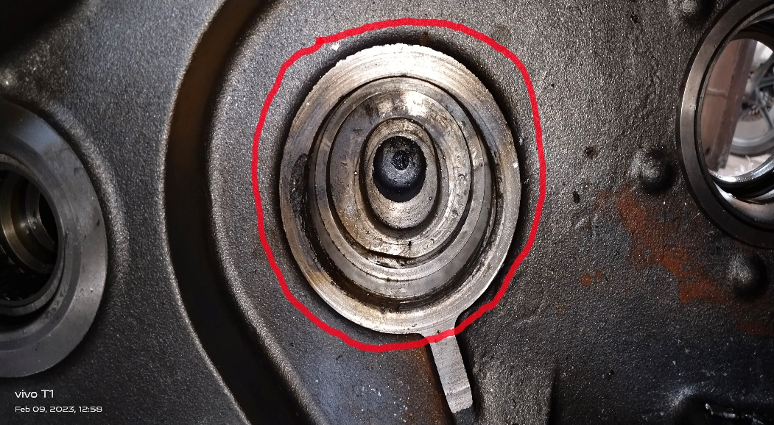
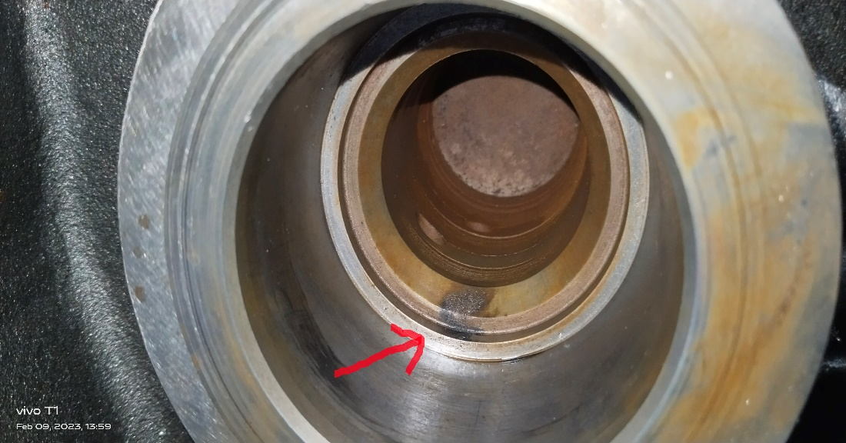
before execution of job
2 Nos. of Bore are damaged

Slide 4
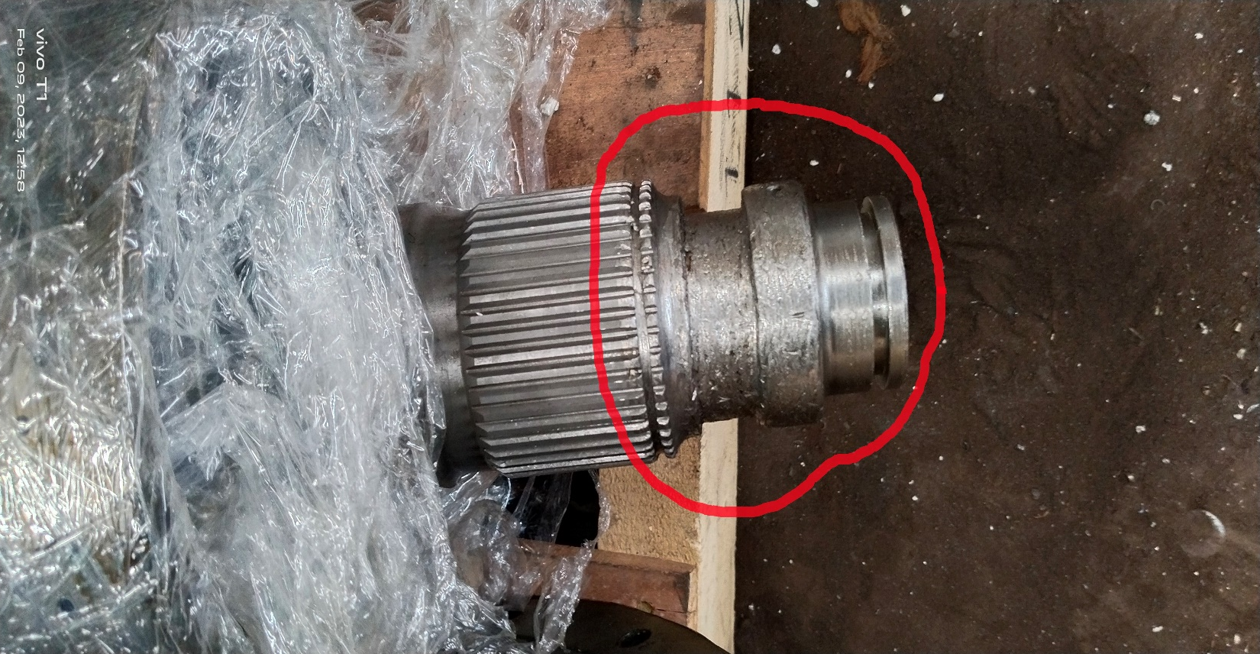
before execution of job
Damaged area of Shaft

Slide 5
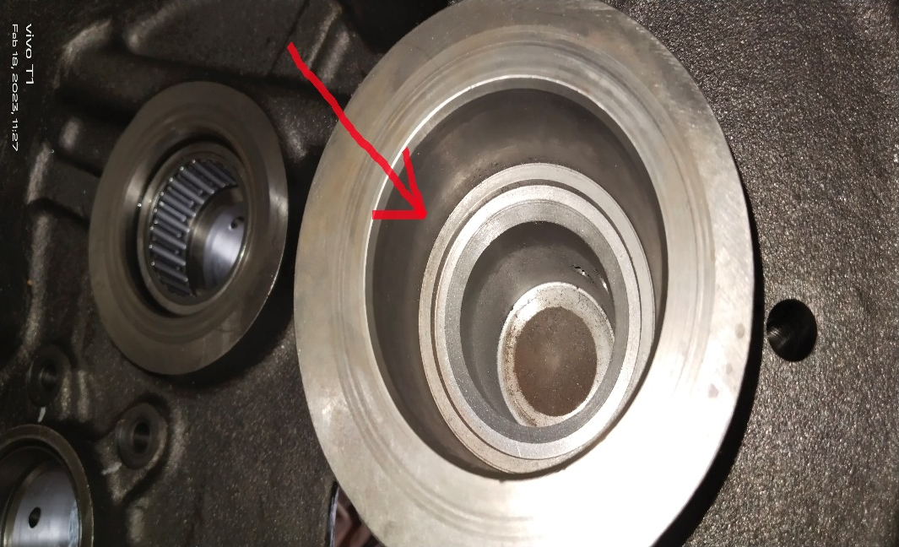
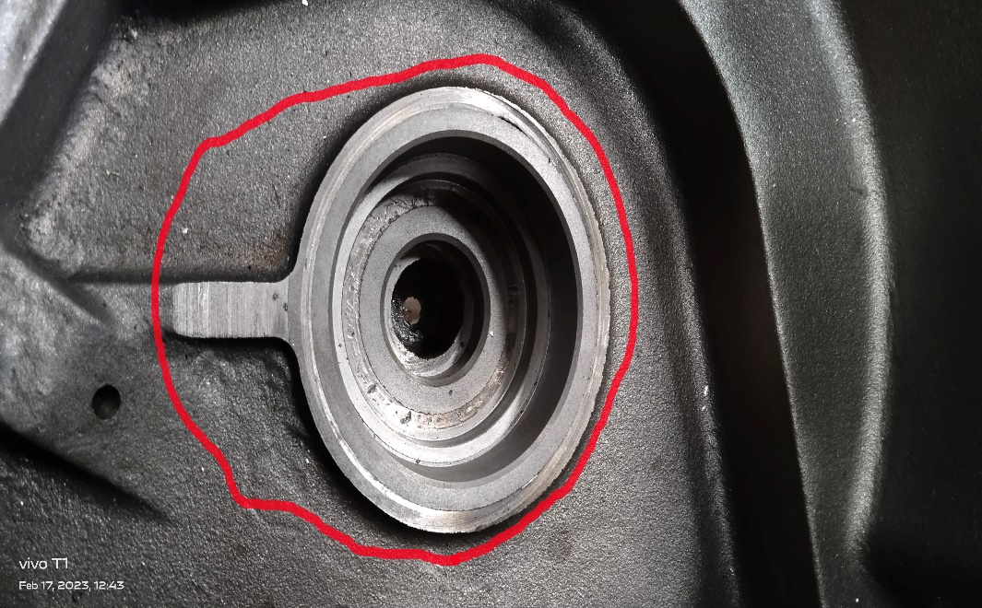
AFTER execution of job
Sleeves are fitted into 2 Nos. of Bore and then machined to get the original profile.

Slide 6
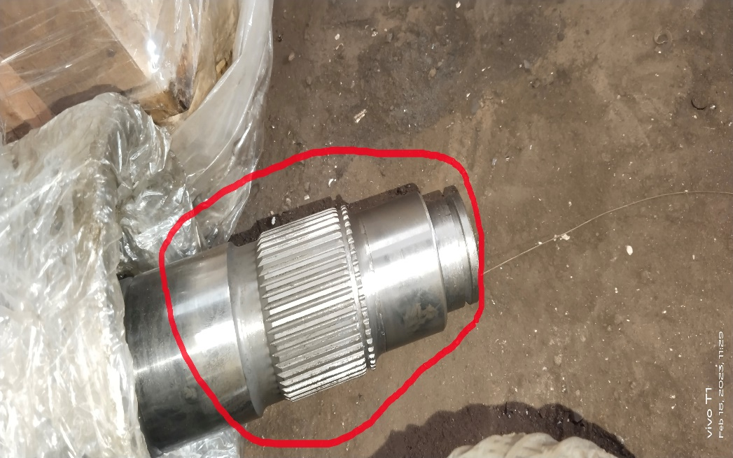
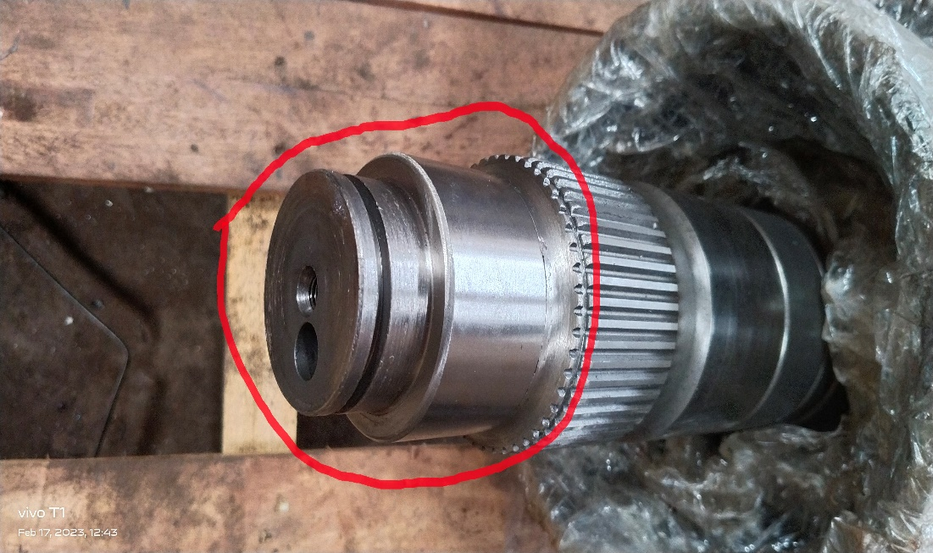
AFTER execution of job
Damaged area of Shaft are repaired by Machining

Slide 7
Cat-3408 Engine block
Worn out & Damaged 32 Nos. of Plugs, 8 Nos. of Top Insert & 8 Nos. of Bottom Insert has been repaired by Machining.

Slide 8
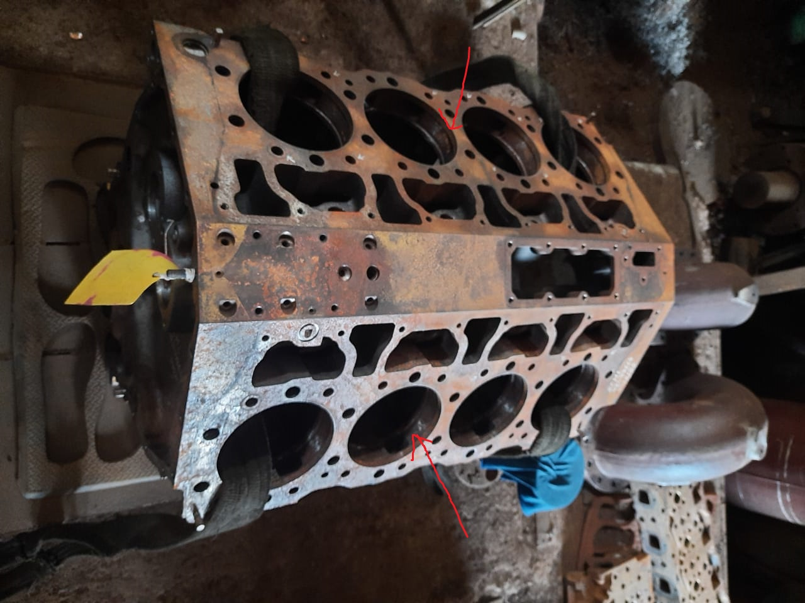
Cat-3408 Engine block
Damaged Plug, Top Insert & Bottom Insert of CAT-3408 Engine Block

Slide 9
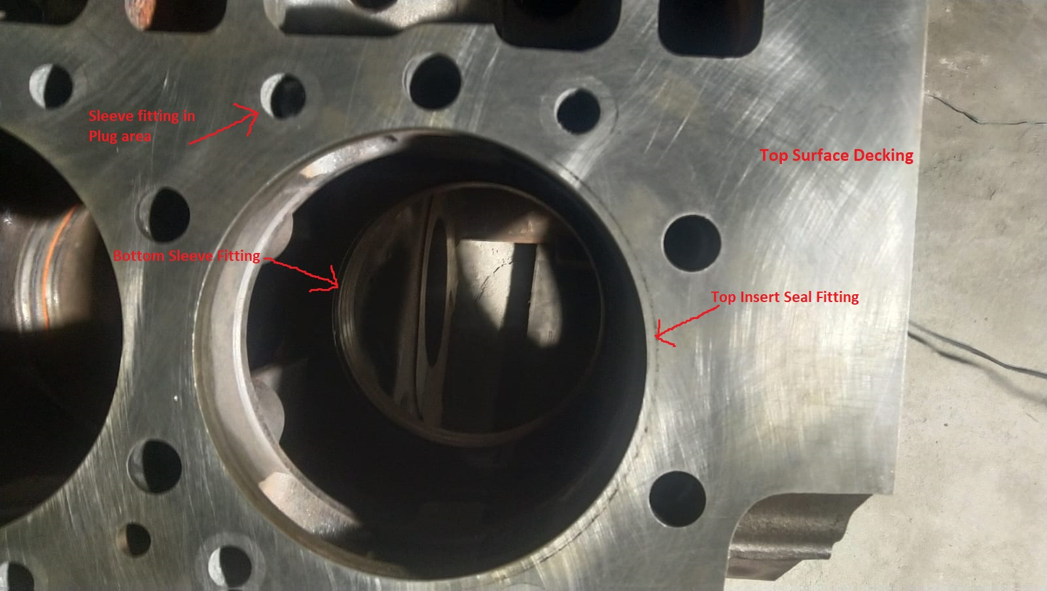
Cat-3408 Engine block
Top Insert Seals has been fitted into Top Insert area, Bottom Sleeves has been fitted into Bottom Insert area and Sleeves has been fitted into Plug area and then machining & Top Surface Decking.

Slide 10
Cat-3508 Engine block
Worn out & Damaged 64 Nos. of Plugs, 8 Nos. of Top Insert & 8 Nos. of Bottom Insert has been repaired by Machining.

Slide 11
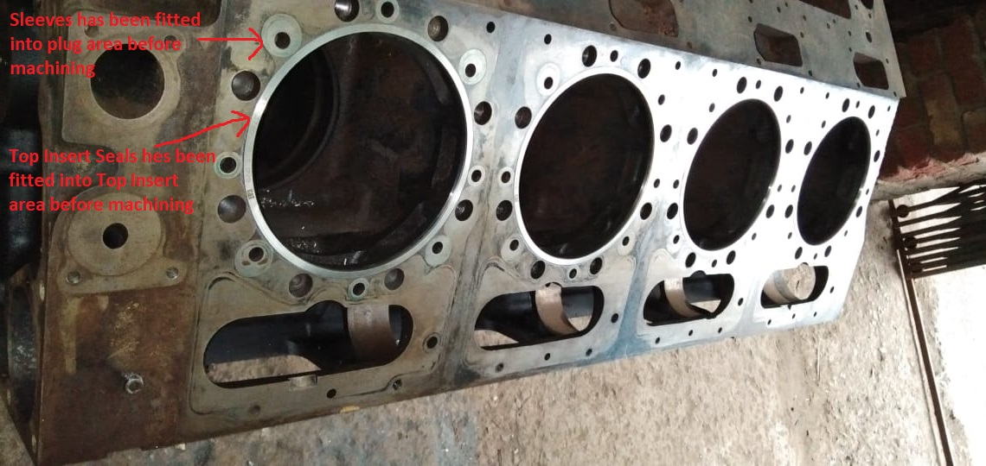
Cat-3508 Engine block
After fitting of Top Insert Seal, Bottom Sleeves and Sleeves into damaged Top Insert area, Bottom Insert area and Plug area of CAT-3508 Engine Block

Slide 12
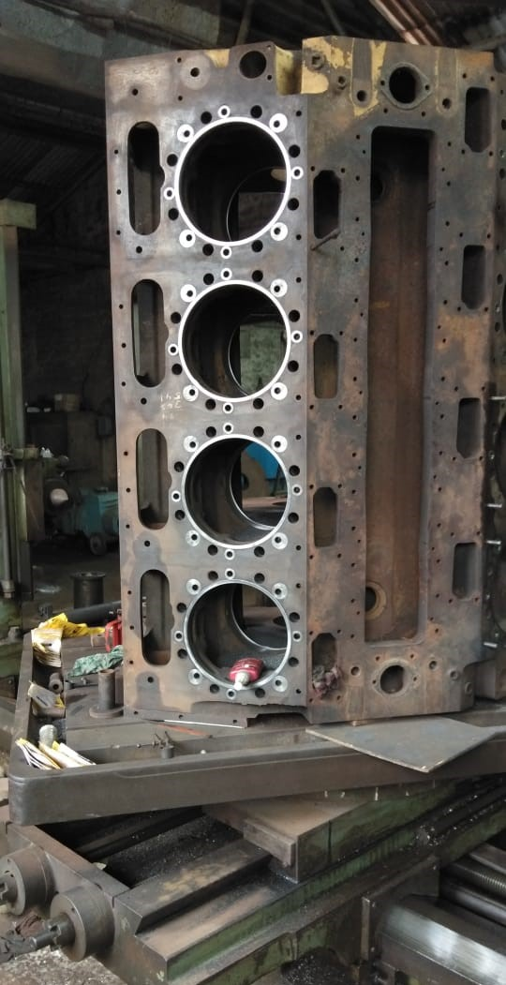
Cat-3508 Engine block
During Machining

Slide 13
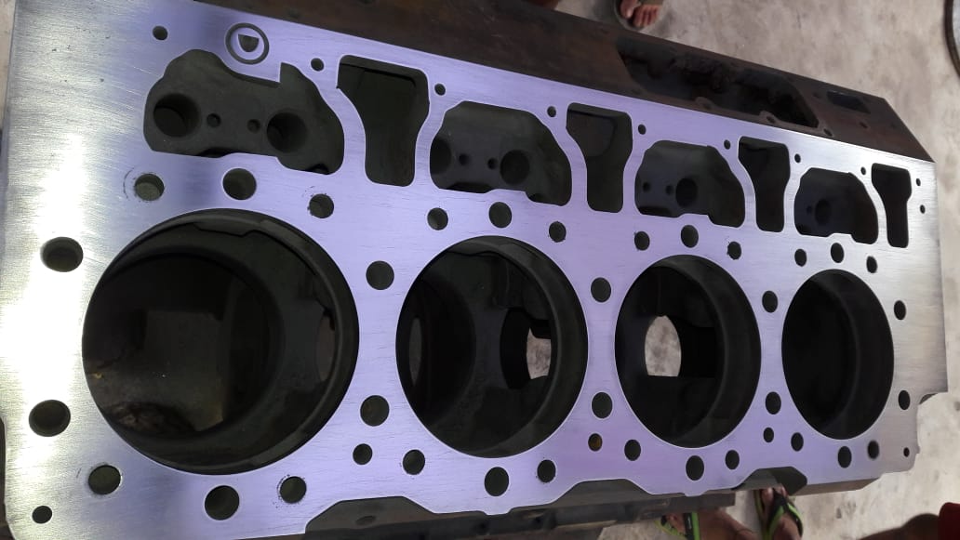
Cat-3508 Engine block
Top Surface Decking Completed after all Machining job

Slide 14
THANK YOU

