Slide 1
Case Study service: Metal Stitching equipment: repairing of transmission housing
EKA PRESS TECHNO SERVICES PVT. LTD.

Slide 2
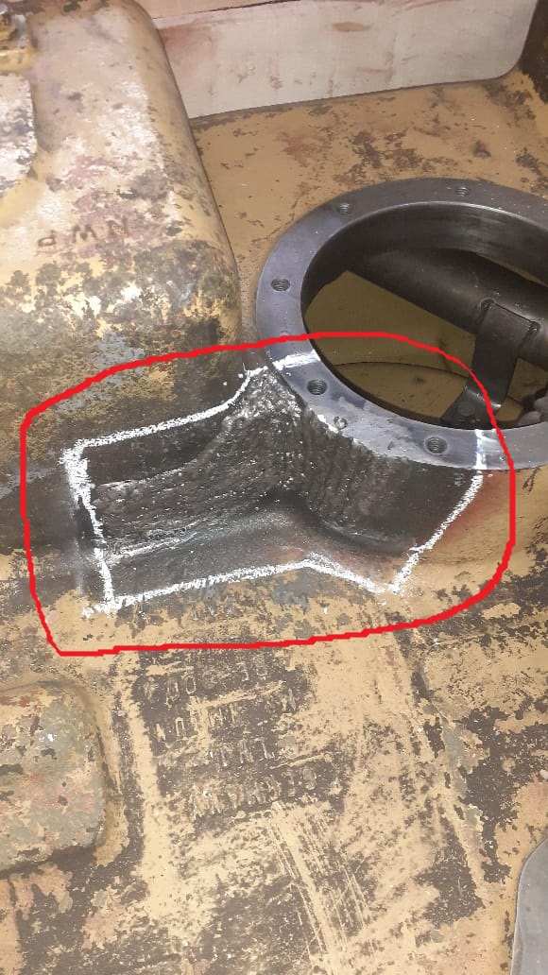
inspection
The welded part was broken in Transmission Housing.
After inspection we determined that it can be repaired using a new casting piece by Metal Stitching process.

Slide 3
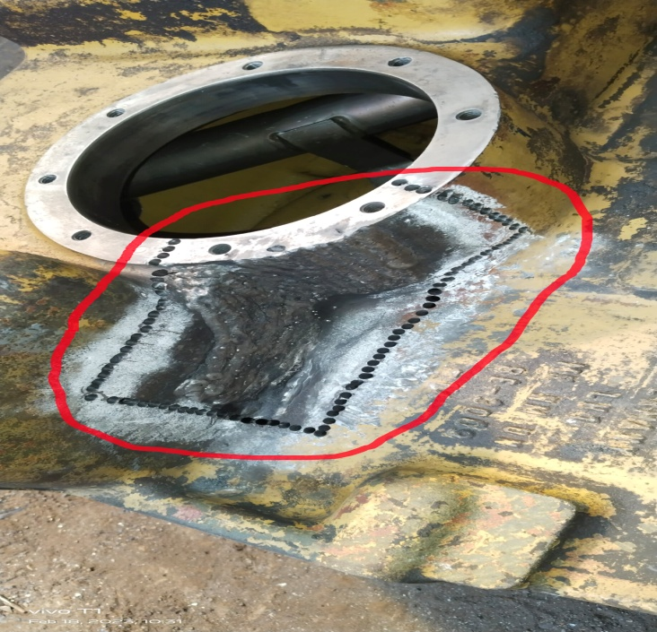
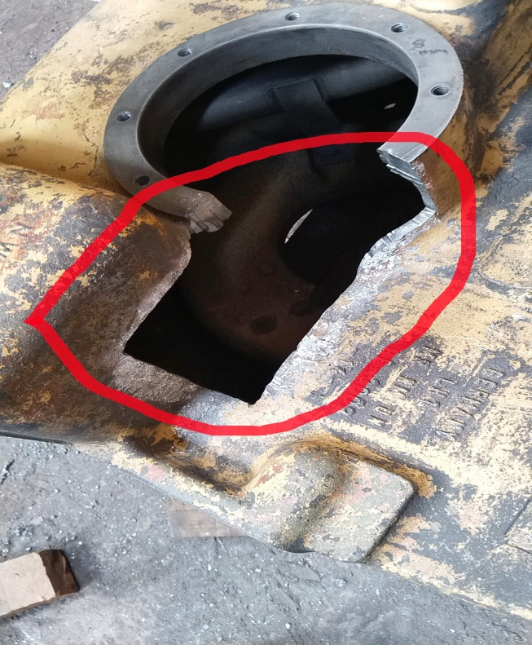
Before execution of job
The Broken Welded part has been drilled by using Pneumatic Drill Machine from surroundings of it to remove it from the body.
The Broken Welded part has been removed by Pneumatic Drilling Procedure.
The total length of the Broken area= 30”
Thickness of the body= 8-10 mm

Slide 4
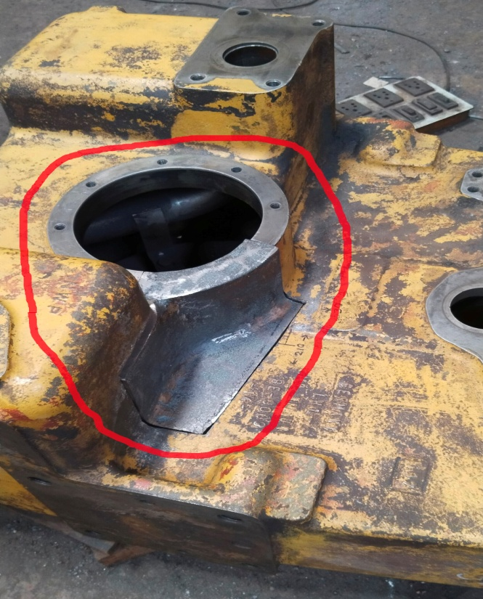
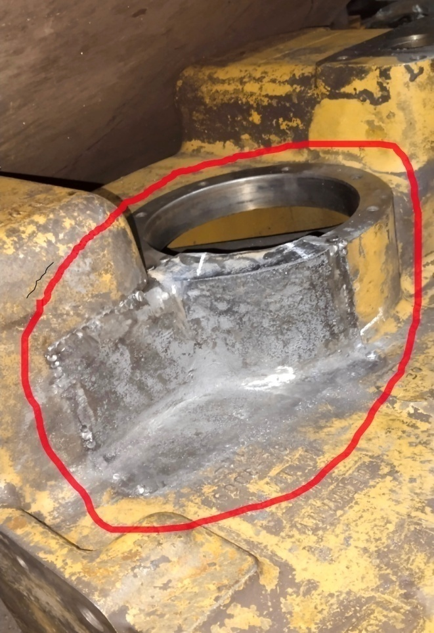
execution of job
A new CI Casting Piece has been made as per the profile of Broken Part and putting this Casting Piece on the broken area.
The Metal Stitching has been done by using 4 mm & 6 mm Keys to hold the Casting Piece with the remaining part of the Transmission Housing.

Slide 5
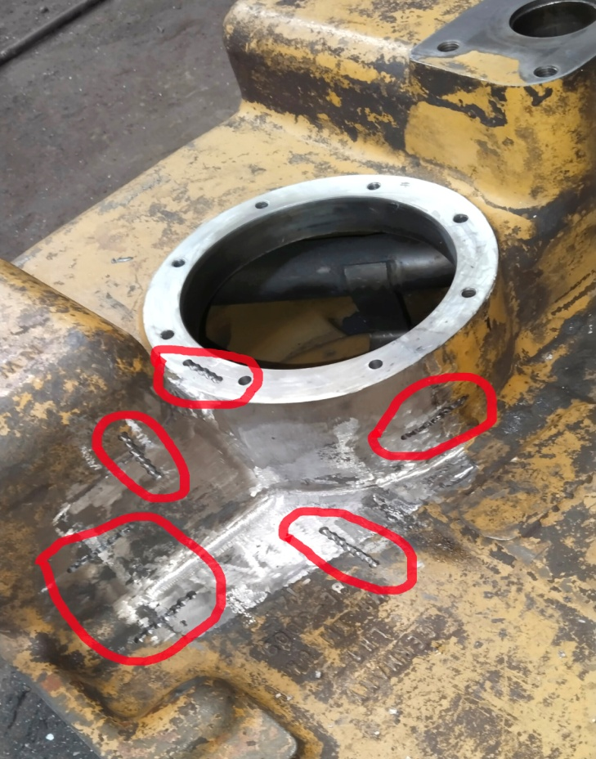
execution of job
The L-15 Locks of Lock-N-Stitch, Inc., USA has been inserted across the stitched portion of Transmission Housing for making it Leak proof Repair.

Slide 6
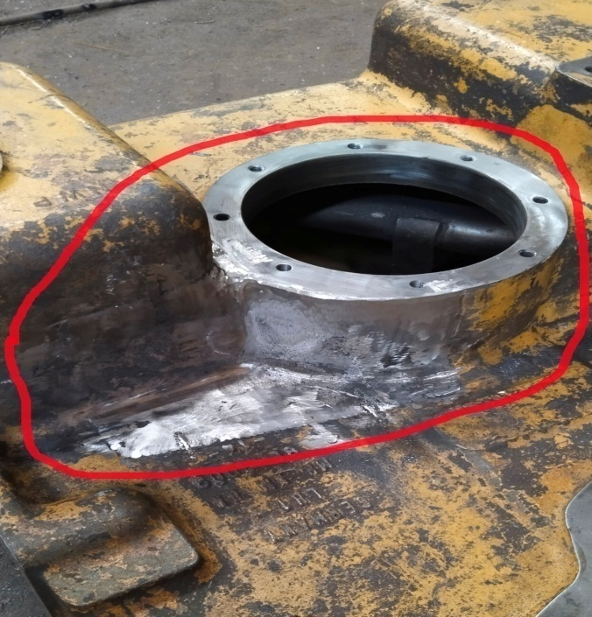
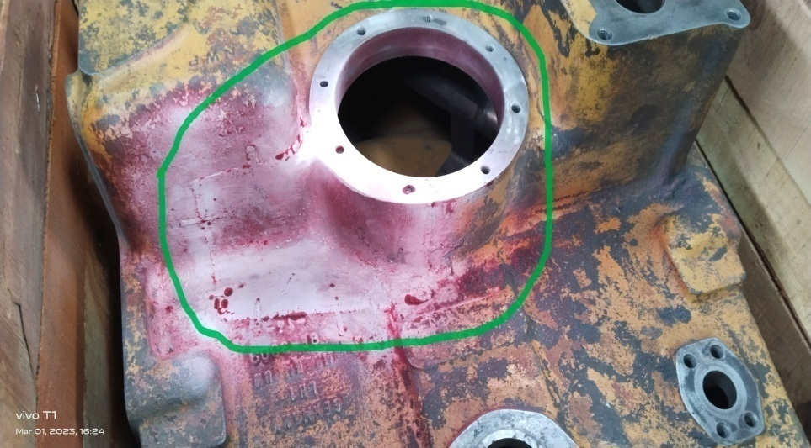
After execution of metal stitching
After completion of Leak proof Metal Stitching procedure, the repaired area has been ground finished to achieve the original profile of Transmission Housing.
Dye Penetration Test has been conducted to check for further crack in repaired area.

Slide 7
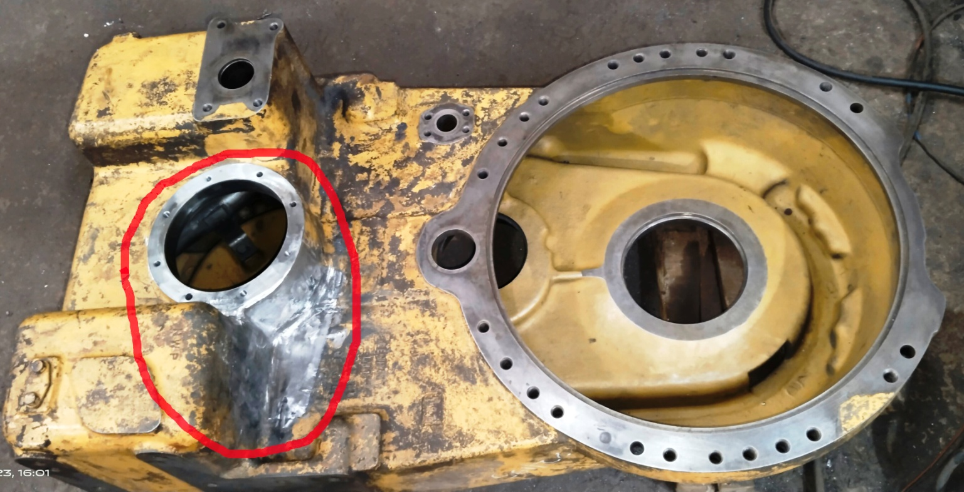
After completion of metal stitching
After Completion of repairing of the Broken Area of Transmission Housing

Slide 8
THANK YOU

