Slide 1
Case Study service: COATING equipment: COATING of Y PIECE OF COAL MILL
EKA PRESS TECHNO SERVICES PVT. LTD.

Slide 2
Y-PIECE OF COAL MILL
In a 250 MW thermal power station, the Y-piece is getting eroded very quickly due to coal dust in the coal mill area. This erosion can be repaired by Erosion Protection Coating.

Slide 3
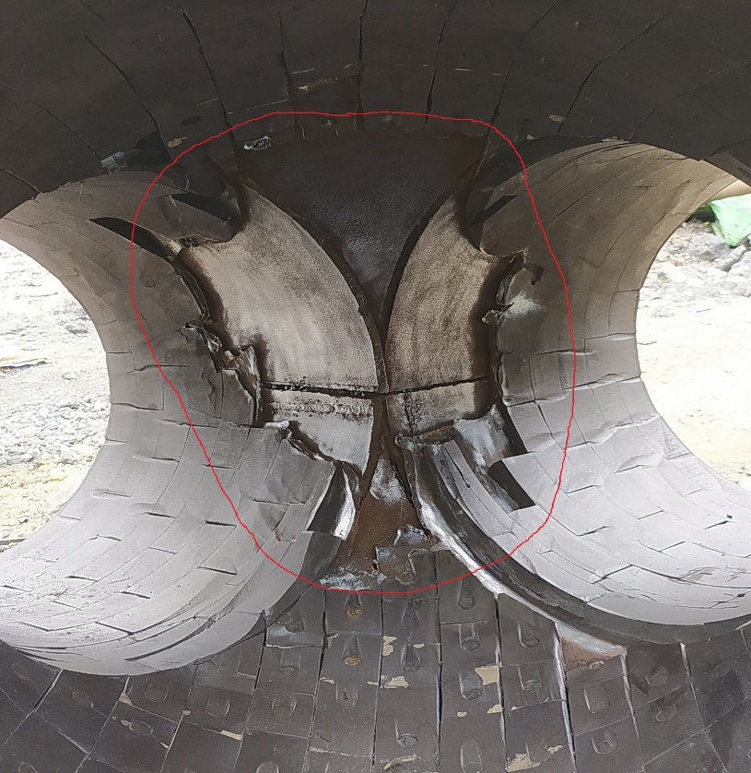
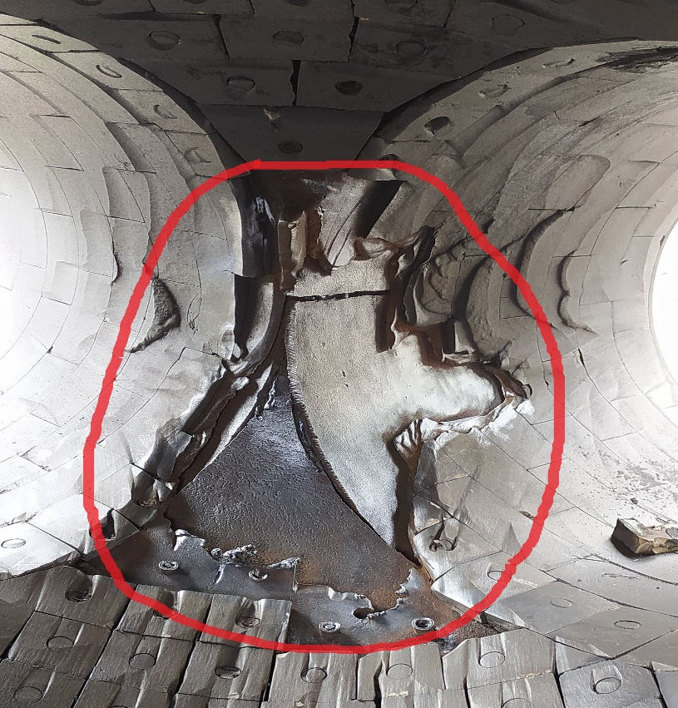
before application
Eroded Y-Piece of Coal Mill due to Coal Dust

Slide 4
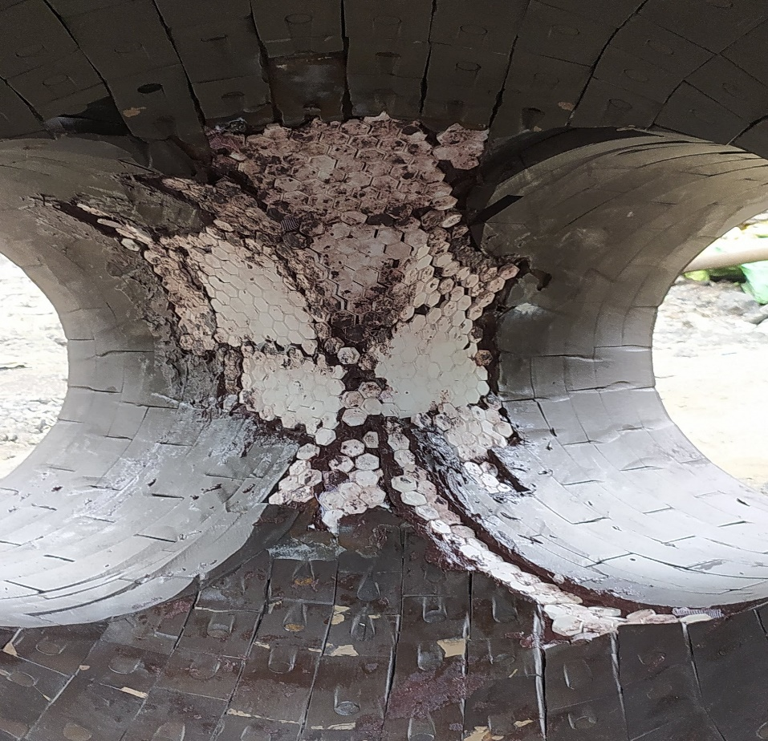
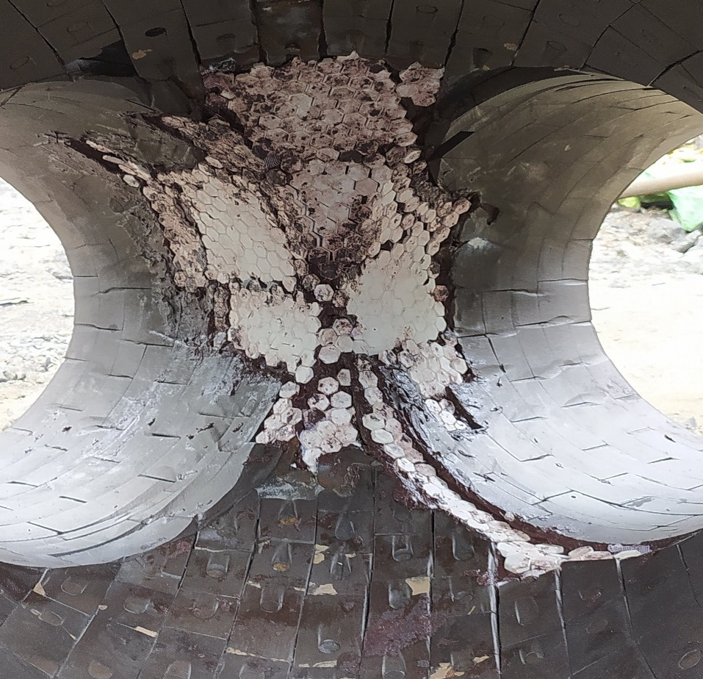
During application
HAR & Durotiles of Duromar are used to protect it from being eroded by Coal Dust

Slide 5
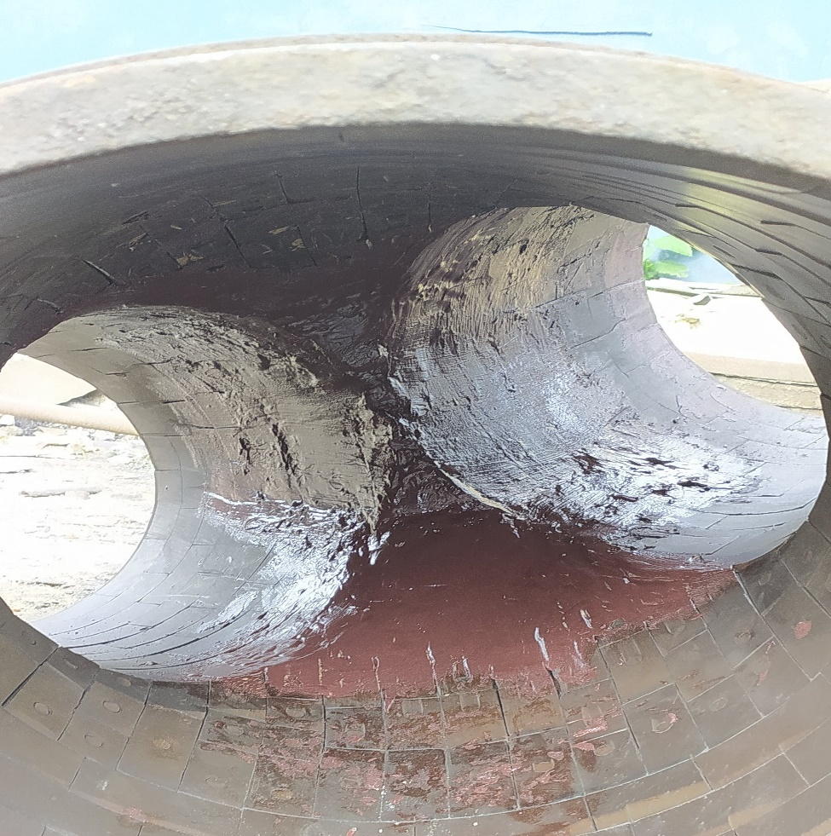
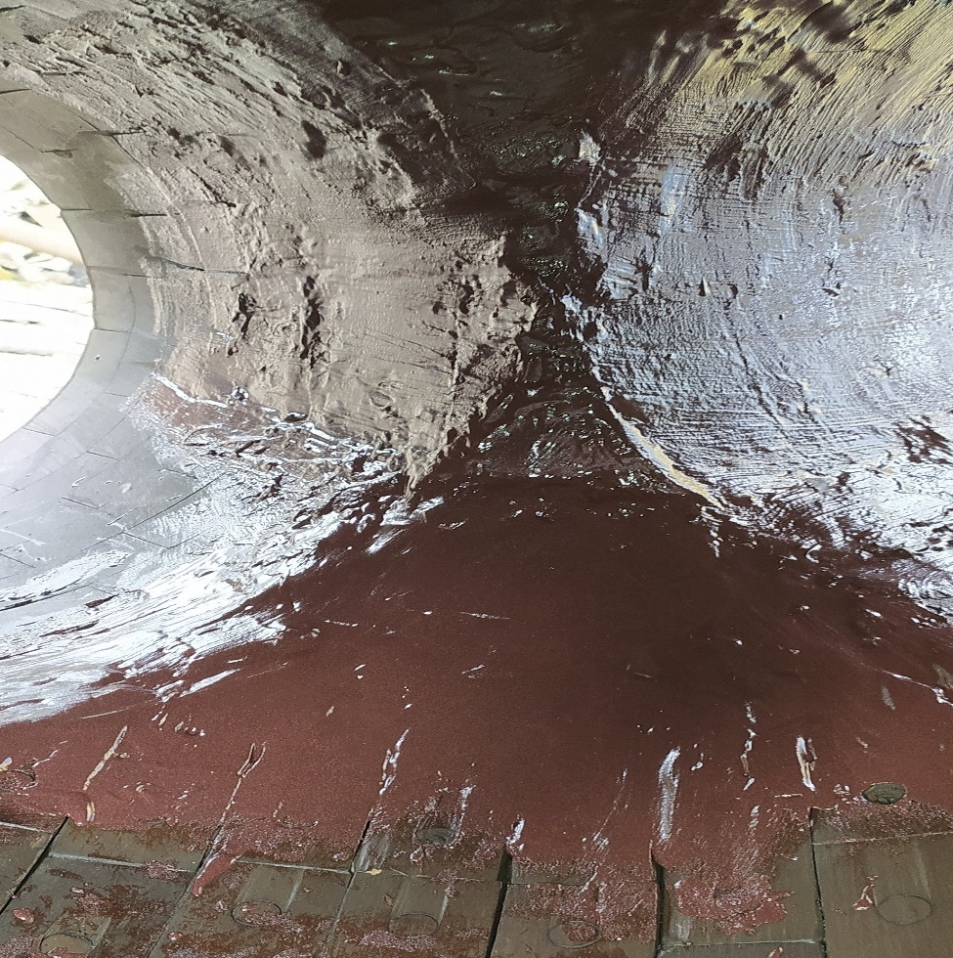
after application
Eroded Y-Piece is cured after completing the Coating Application using HAR & Durotiles of Duromar

Slide 6
THANK YOU

